Slide 1
Introduction to Arduino and Robotics
Welcome to the Wonderful World of Makers!

Slide 2
WELCOME!
Girl Develop It is here to provide affordable and accessible programs to learn software through mentorship and hands-on instruction.
Some "rules"
We are here for you!
Every question is important
Help each other
Have fun

Slide 3
Upcoming Events
Nov 1 – Code & Coffee (free)
2016
Introduction to HTML and CSS
Introduction to Programming with Python
Introduction to Databases and SQL (I & II)
More!

Slide 4
Introductions
Name
Favorite Holiday

Slide 5
What Are Little Bots Made Of?
Foam board
Old CDs
Electrical Box
Yardsticks
Flexible Cutting Board
DUCT TAPE!!!

Slide 6
Robot
a mechanism guided by automatic controls
Mechanism
Motors
Guided
Sensors
Automatic Controls
Microprocessor
Code

Slide 7
Robot
Hardware
Microprocessor
Sensors
Motors
Power
Software
Code

Slide 8
Robot
Hardware
Microprocessor
Sensors
Motors
Power
Software
Code

Slide 9
Microprocessor
Lego Mindstorm
Raspberry Pi
Arduino

Slide 10
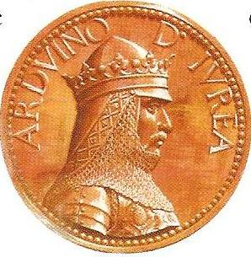
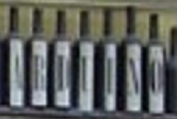
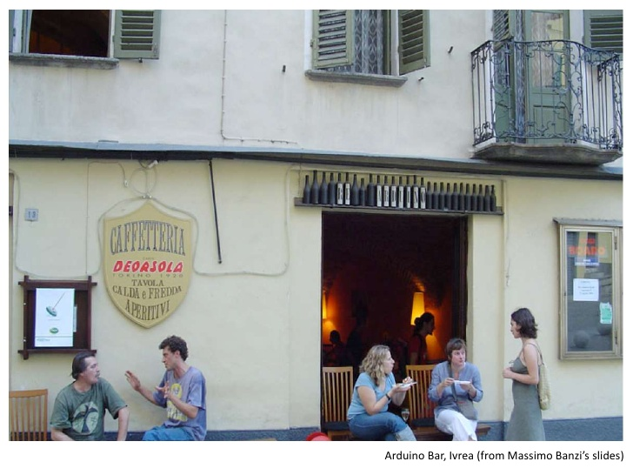
In The Beginning…
The first Arduino
955 – 1015 A.D
King of Italy 1002-1014
Arduino Namesake
Bar in Ivrea Italy

Slide 11
Arduino Microprocessor
Designed by 5 students
Goals
Affordable
Open Source
Easy to program for beginners

Slide 12
Arduino Microprocessor – Success!
Goals
Affordable
< $30
Open Source
Creative Commons license
Easy to program for beginners
700,000 + Official Arduino Boards sold (2013)

Slide 13
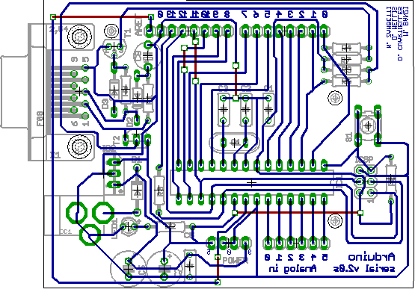
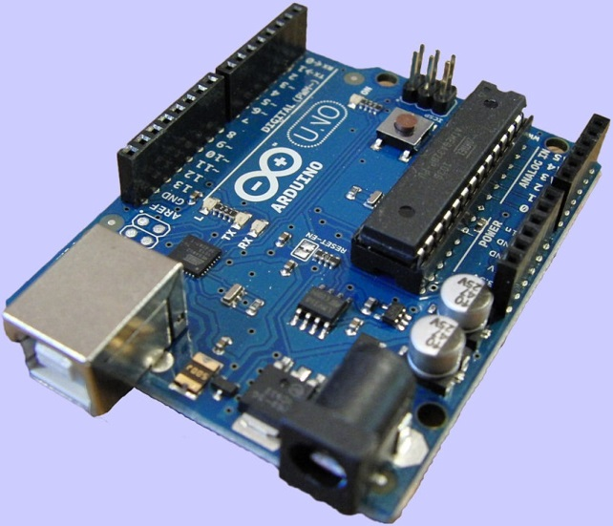
Arduino As We Know It
Arduino (2005)
First board / design
Arduino Uno (2010)
R3 Released 2013

Slide 14
Arduino Boards
Arduino Uno R3
Arduino Yun (linux and Wifi built in)
Trinket Pro (Arduino compatible)
Shields
Motor / Servo controllers
BlueTooth LTE
GPS
Data Logging
Many more!

Slide 15
Arduino
But what can it do?

Slide 16
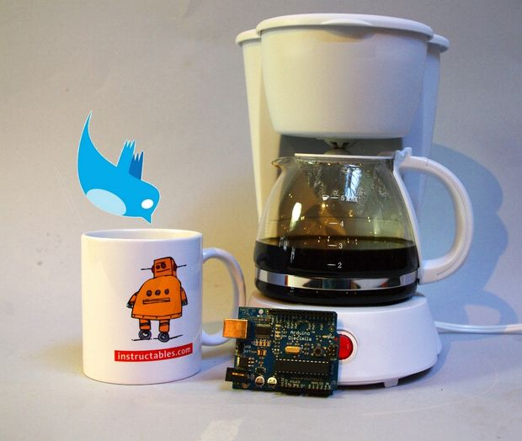
The Cardboard Box for Geeks
Twitter enabled coffee maker.

Slide 17
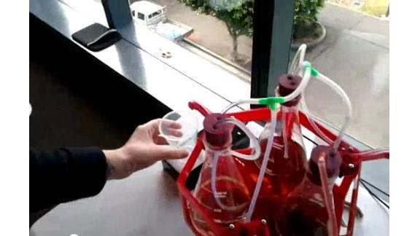
The Cardboard Box for Geeks
Remote Bartender.

Slide 18

The Cardboard Box for Geeks
Shoes that flash when you walk.

Slide 19
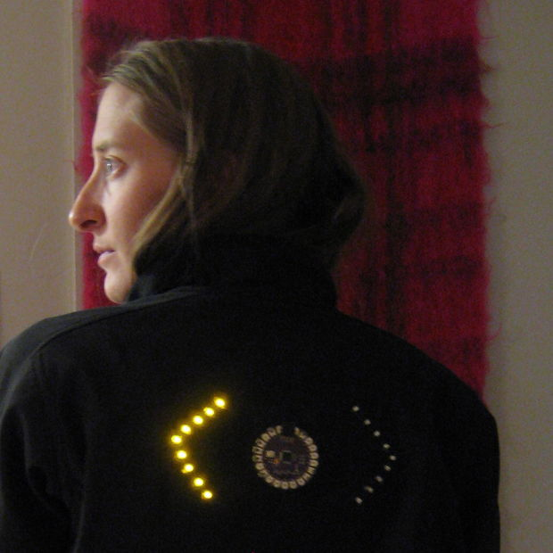
The Cardboard Box for Geeks
Turn Signal Jacket.

Slide 20
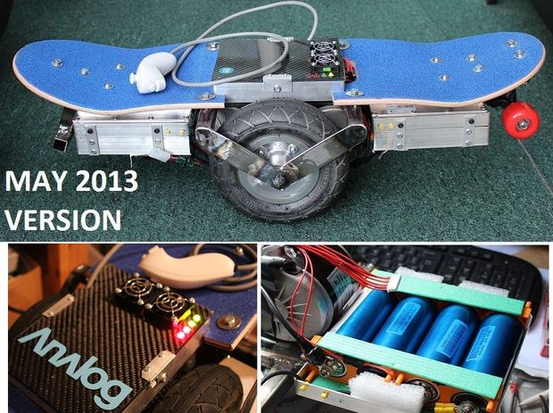
The Cardboard Box for Geeks
Segway style skateboard.

Slide 21
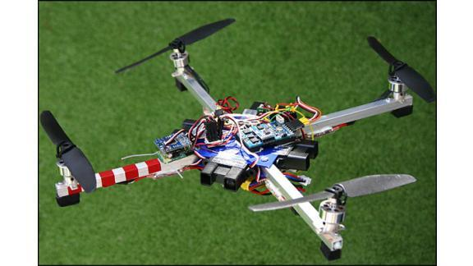
The Cardboard Box for Geeks
Quadcopters!

Slide 22
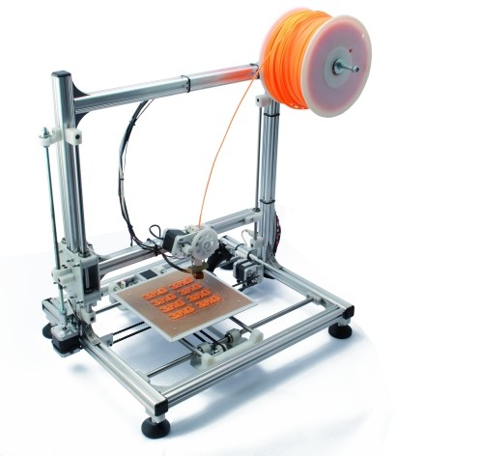
The Cardboard Box for Geeks
3D Printers!

Slide 23
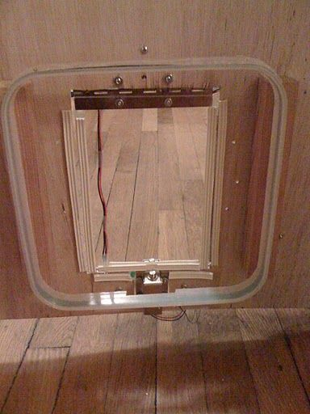
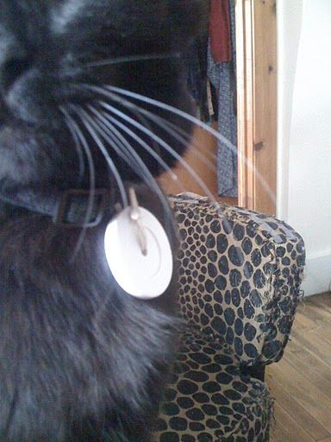
The Cardboard Box for Geeks
RFID Cat Door

Slide 24
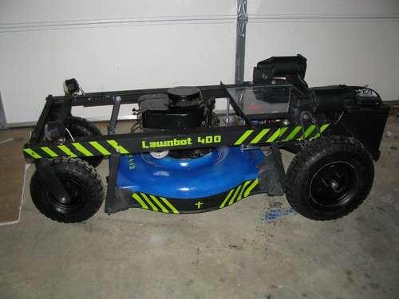
The Cardboard Box for Geeks
Remote Controlled Lawnmower.

Slide 25
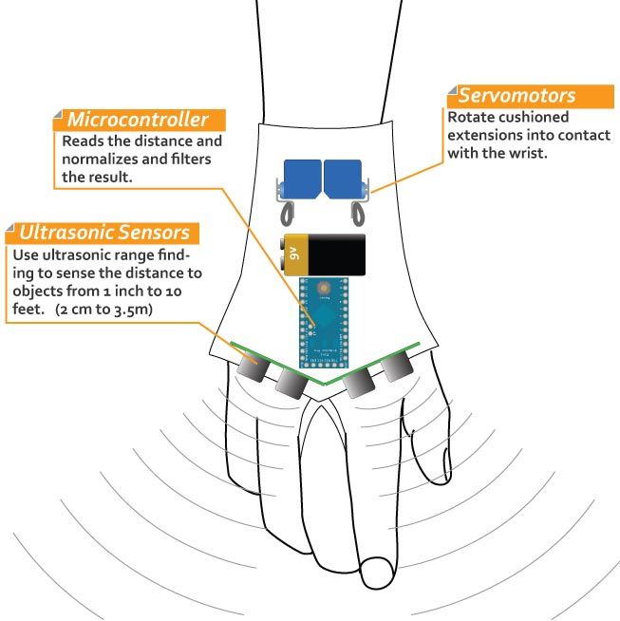
The Cardboard Box for Geeks
Sonic Glove for the blind.

Slide 26

The Cardboard Box for Geeks
Flame throwing Jack O’ Lantern.

Slide 27
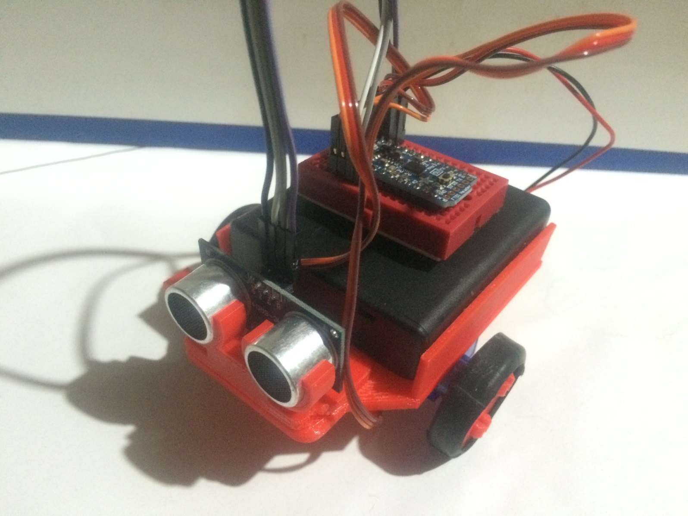
The Cardboard Box for Geeks
GeeDee
BOTS!

Slide 28
Robot
Hardware
Microprocessor
Sensors
Motors
Power
Software

Slide 29
GeeDee bot
Hardware
Microprocessor
Adafruit Pro Trinket – 5V
Sensors
Motors
Power
Software
Arduino IDE

Slide 30
Robot
Hardware
Microprocessor
Sensors
Motors
Power
Software

Slide 31
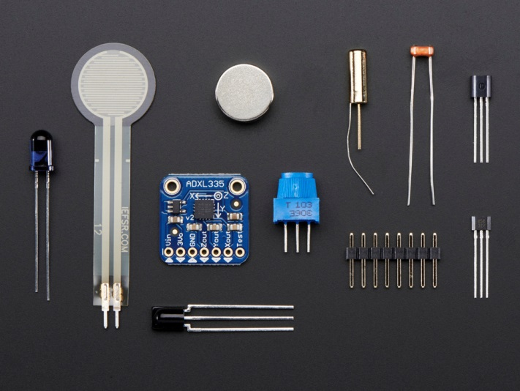
Sensors
Movement
Distance
Light
Environment
Pressure

Slide 32
Movement Sensors
Accelerometer
How fast?
Gryo
Tilt & Direction
Compass
Direction
Proximity
Detect movement

Slide 33
Distance Sensors
Ultrasonic
Uses sound waves
Laser
Uses laser light
Encoder
Revolutions

Slide 34
Light Sensors
Reflectance
Amount of light
Color
Wavelength

Slide 35
Environment Sensors
Temperature
Humidity
Gas

Slide 36
Pressure Sensors
Flex
Weight
Barometric

Slide 37
GeeDee bot
Hardware
Microprocessor
Adafruit Pro Trinket – 5V
Sensors
HC-SR04 Ultrasonic Sensor
Motors
Power
Software
Arduino IDE

Slide 38
Robot
Hardware
Microprocessor
Sensors
Motors
Power
Software

Slide 39
Motors
Electric
Stepper
Servo

Slide 40
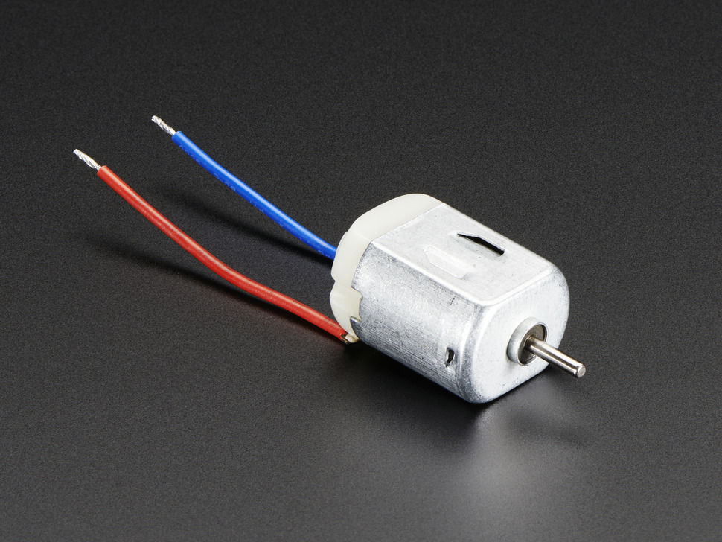
Electric Motors
Voltage (3 – 6 V)
RPM
Gearing
Controller

Slide 41
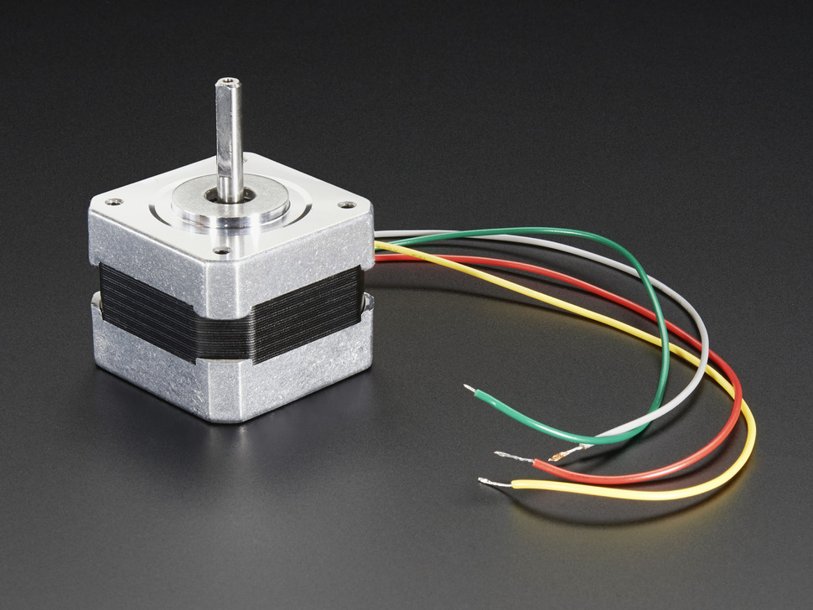
Stepper Motors
Precise movement
Current Draw
Driver
Voltage (12V +)

Slide 42
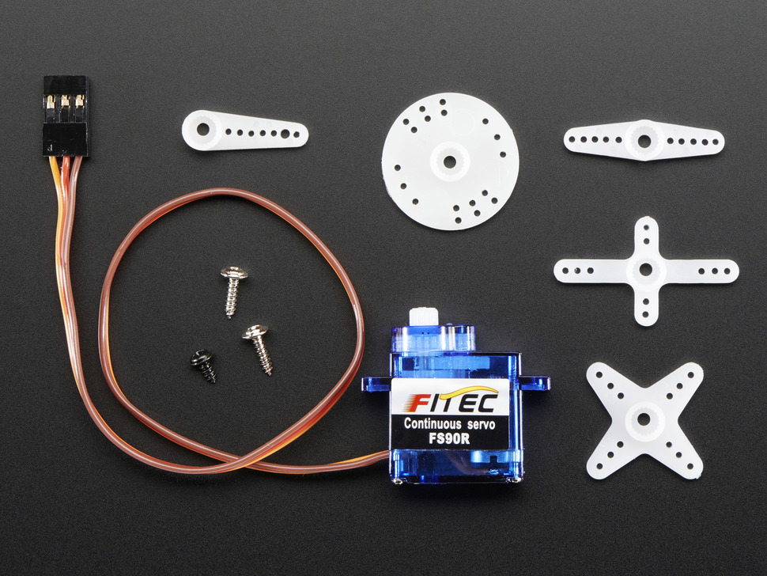
Servo Motors
Limited movement
Continuous Rotation
Signal Pulse

Slide 43
GeeDee bot
Hardware
Microprocessor
Adafruit Pro Trinket – 5V
Sensors
HC-SR04 Ultrasonic Sensor
Motors
Continuous Rotation Servos
Power
Software
Arduino IDE

Slide 44
Robot
Hardware
Microprocessor
Sensors
Motors
Power
Software

Slide 45
Power
Batteries
USB

Slide 46
GeeDee bot
Hardware
Microprocessor
Adafruit Pro Trinket – 5V
Sensors
HC-SR04 Ultrasonic Sensor
Motors
Continuous Rotation Servos
Power
Batteries (4 – AA)
Software
Arduino IDE

Slide 47
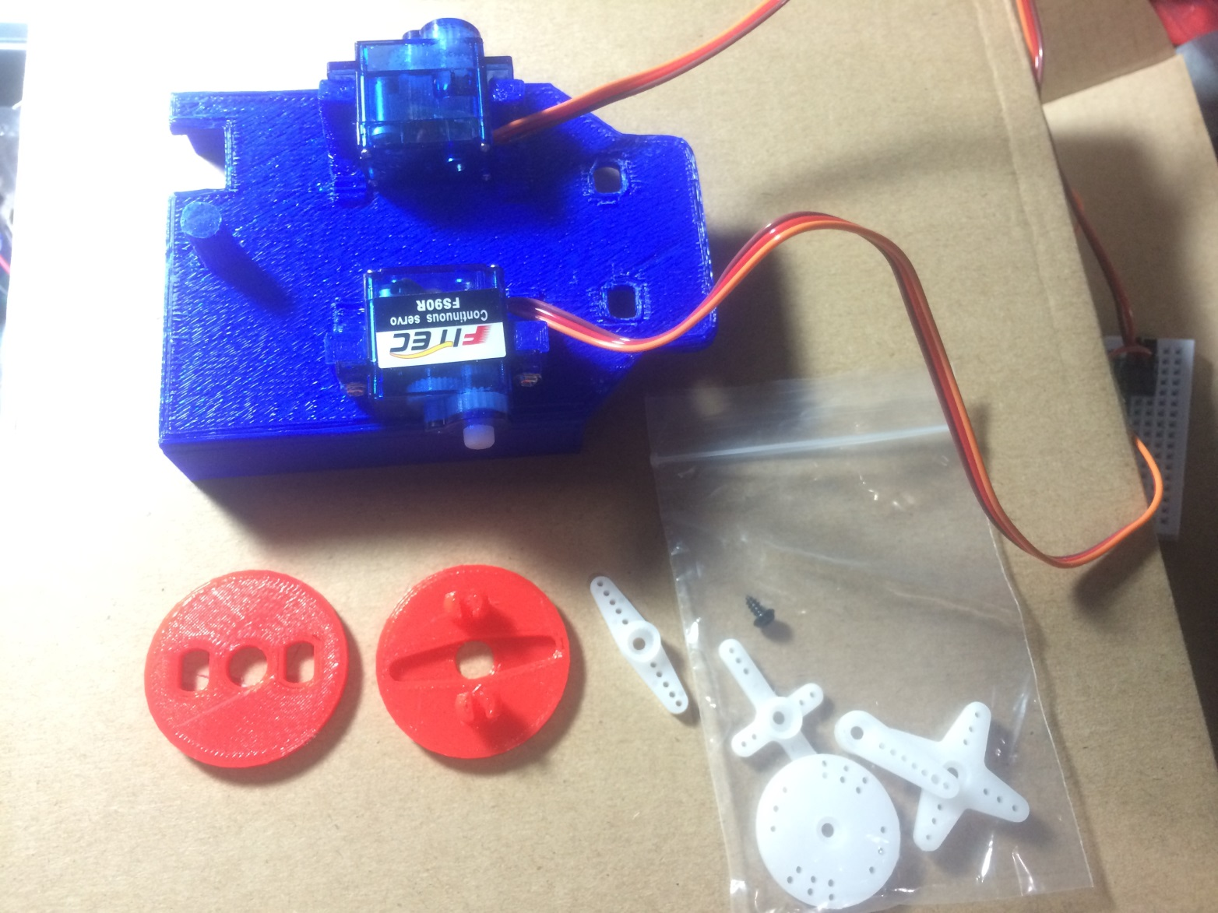
GeeDee Assembly

Slide 48
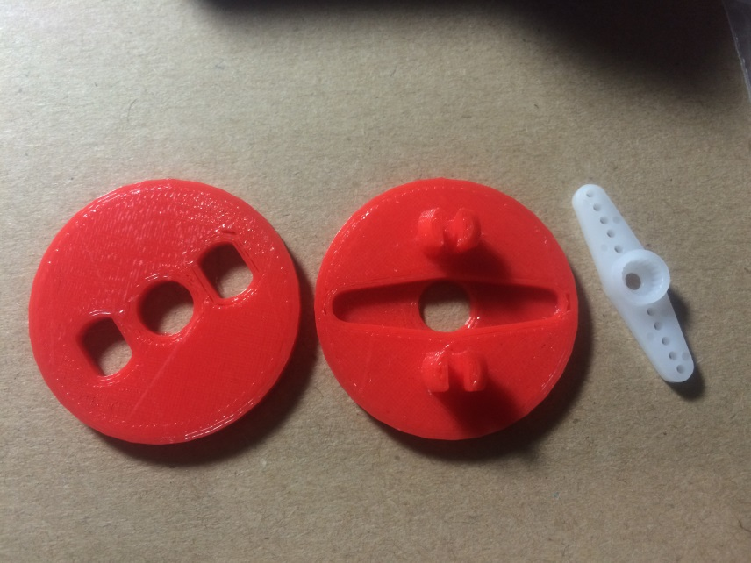
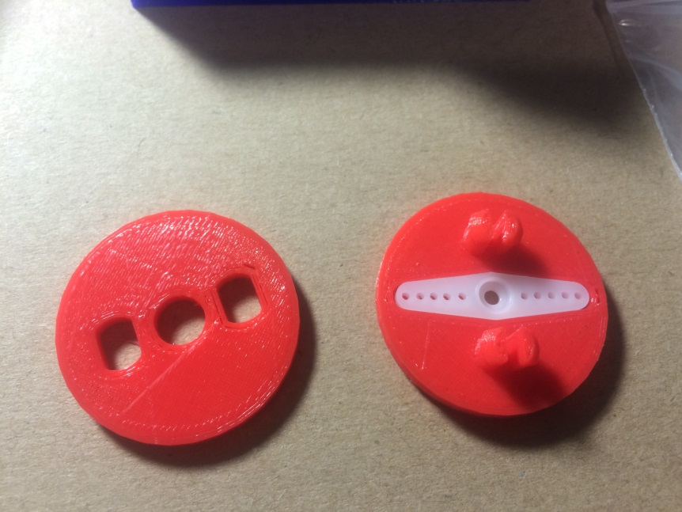
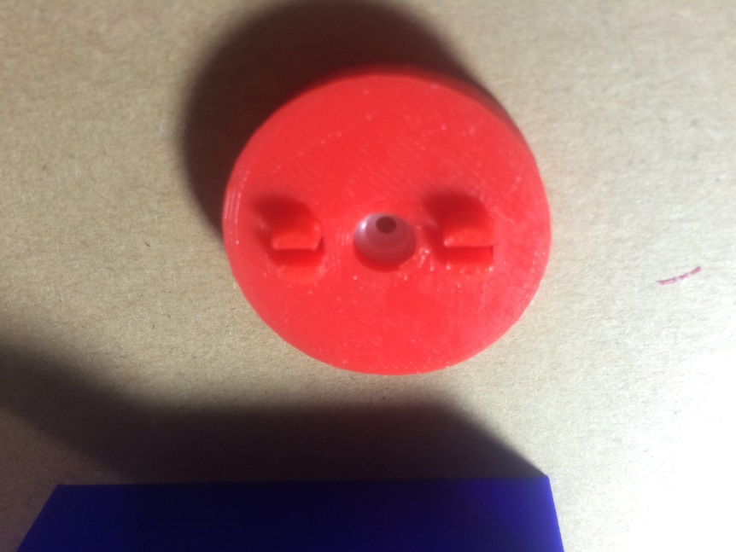
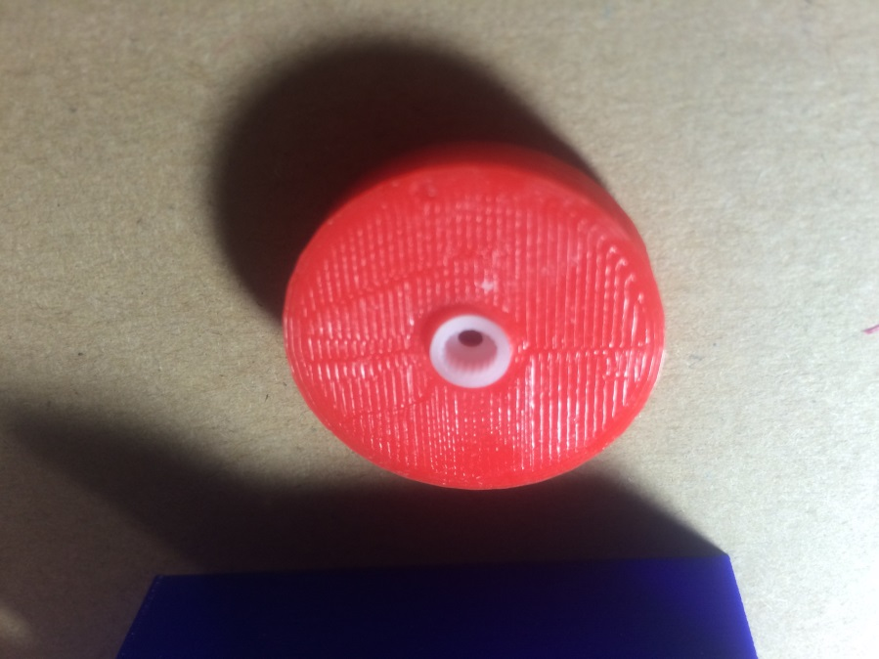
Wheel Assembly

Slide 49
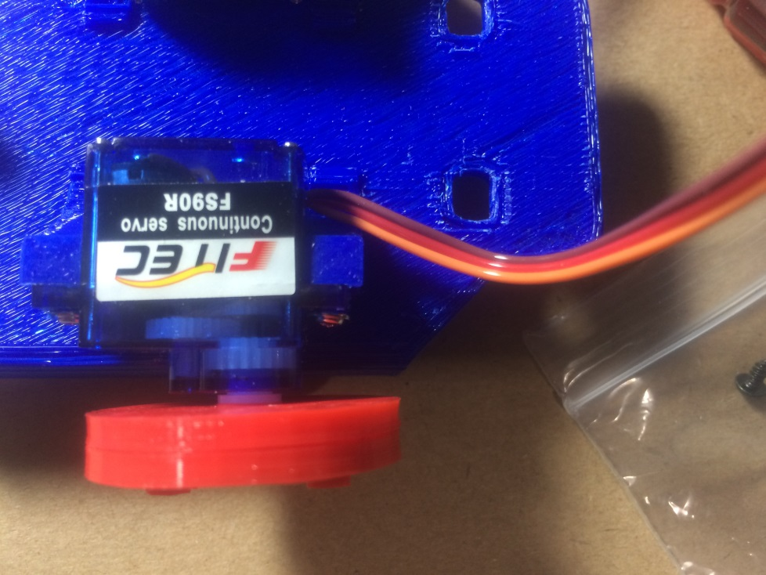
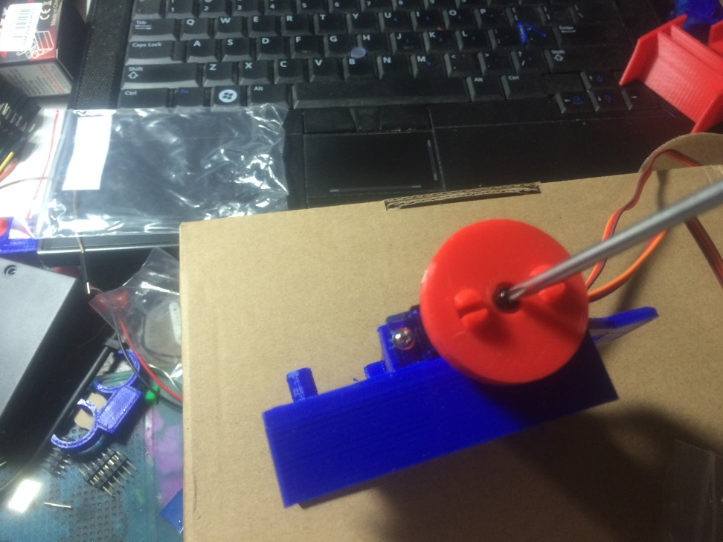
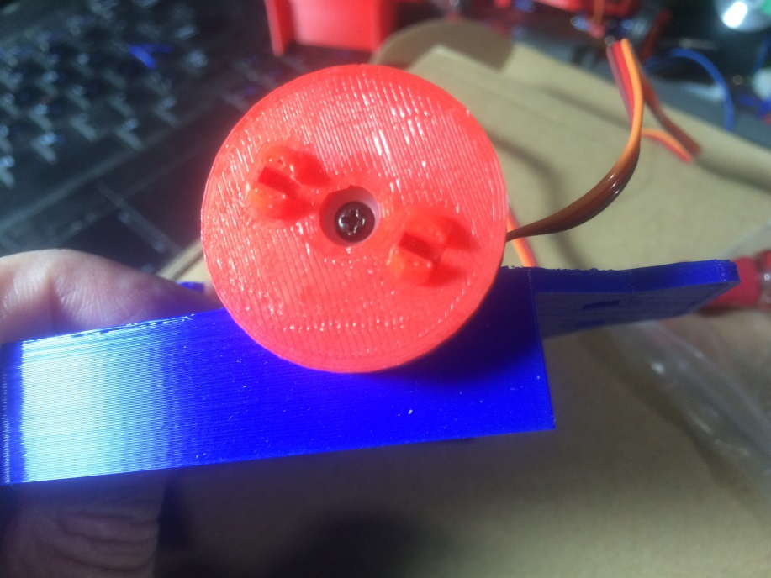
Wheel Mount

Slide 50
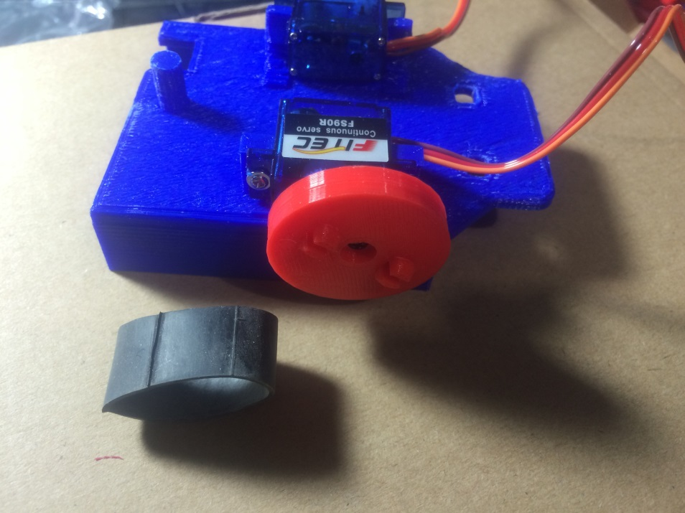
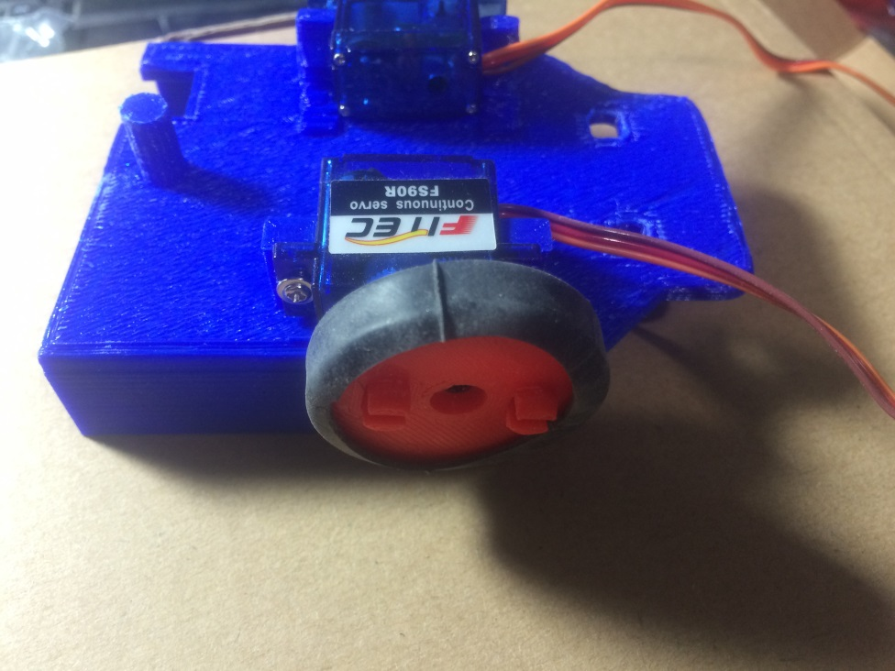
Tires

Slide 51
Connecting the Parts

Slide 52
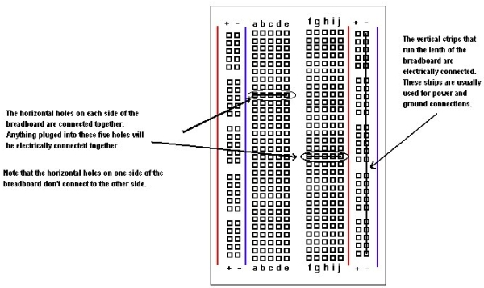
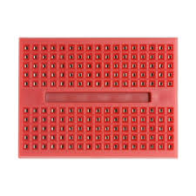
Solderless Breadboard

Slide 53
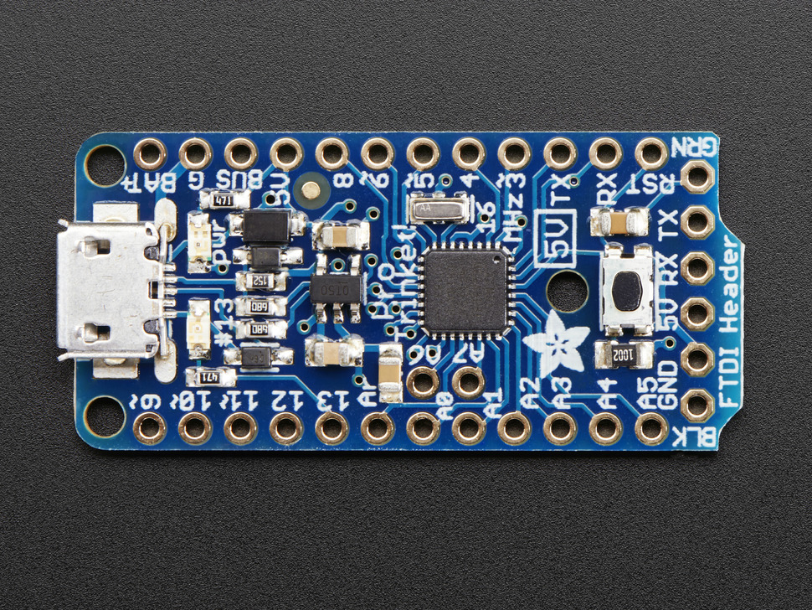
Adafruit Pro Trinket

Slide 54
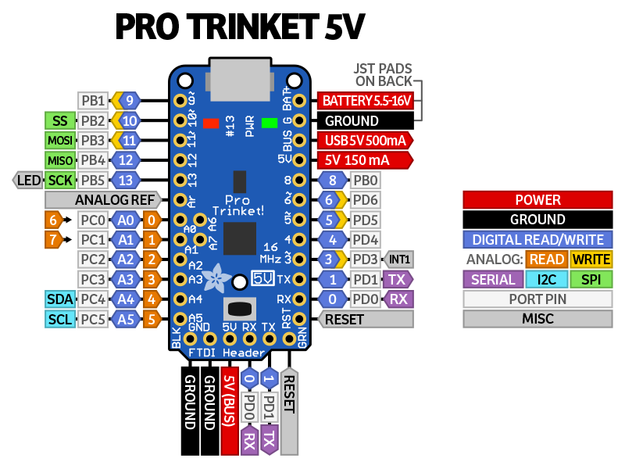
Adafruit Pro Trinket

Slide 55
Adafruit Pro Trinket
Power,
Ground
Servos
Sensor

Slide 56
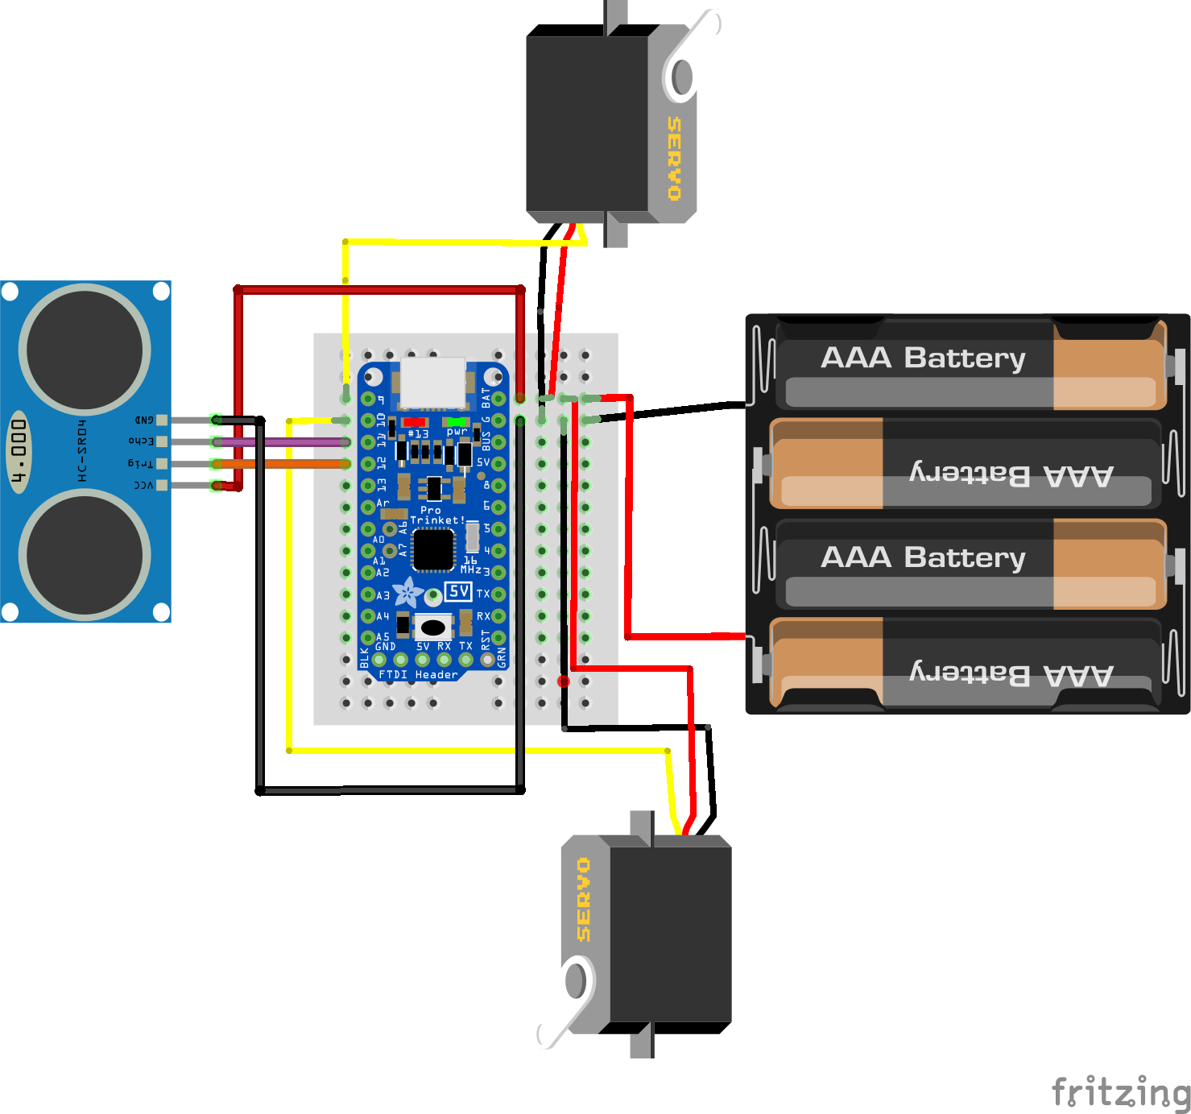
Wiring Diagram

Slide 57
Power
Batteries
USB

